Slide 1
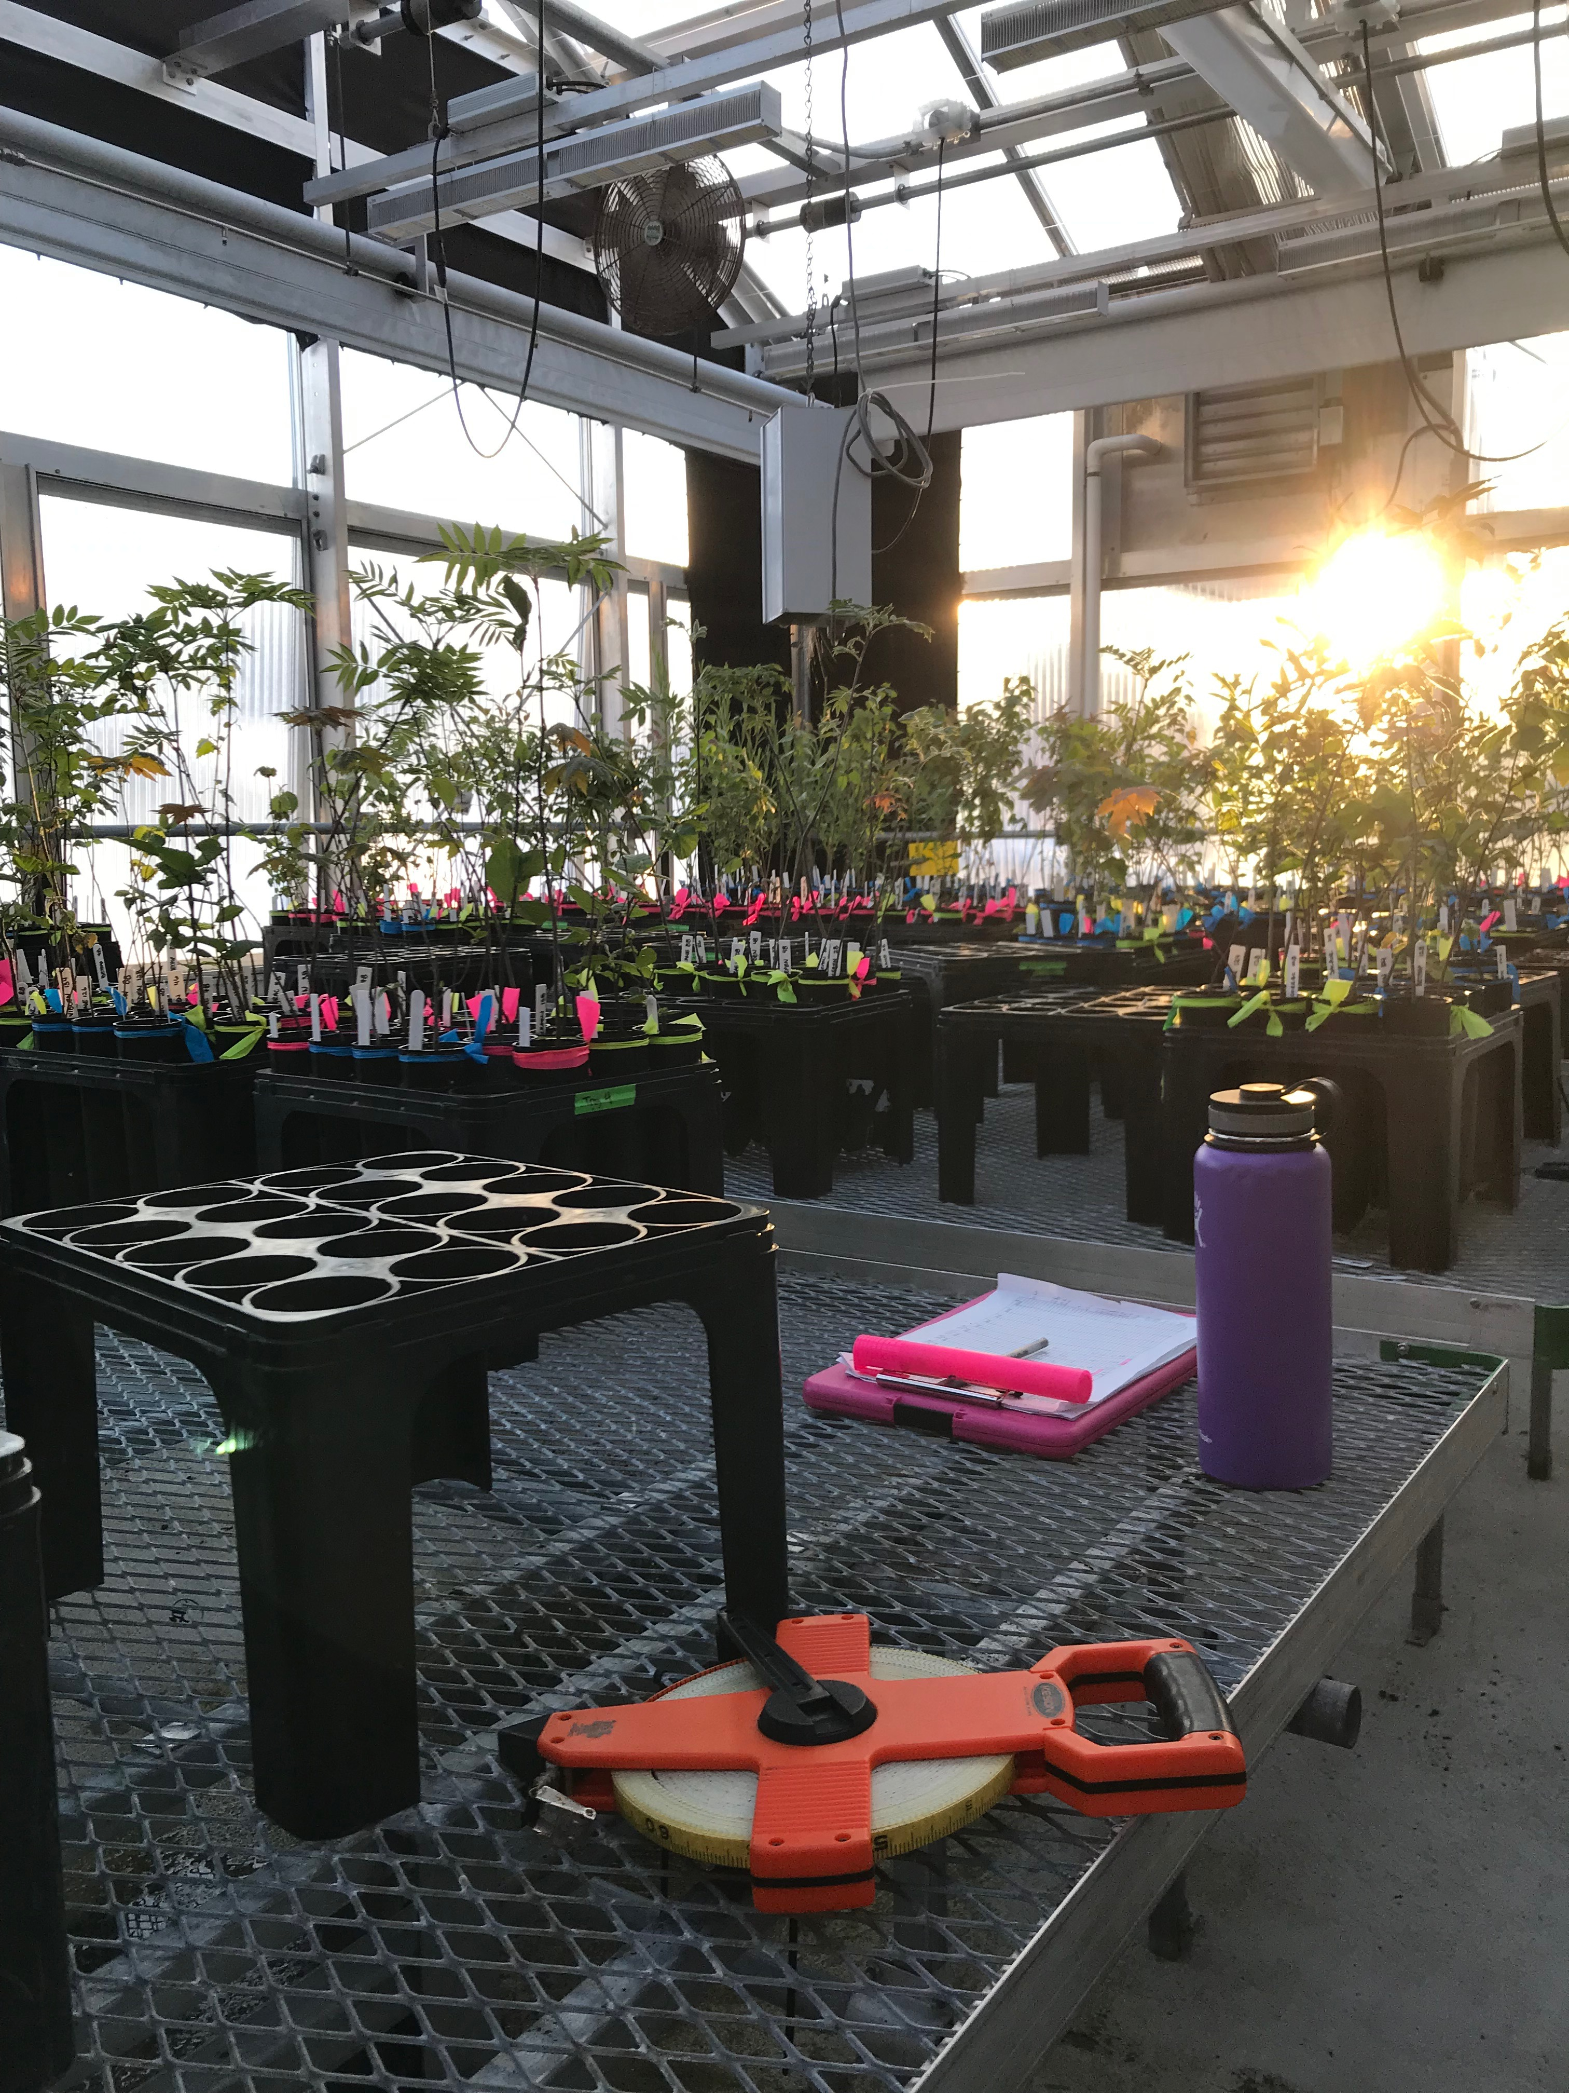
False springs in a warming world

Slide 2
Frost tolerance

Slide 3
Species differences: tolerance vs avoidance
Duration of Vegetative Risk
Duration of Vegetative Risk

Slide 4
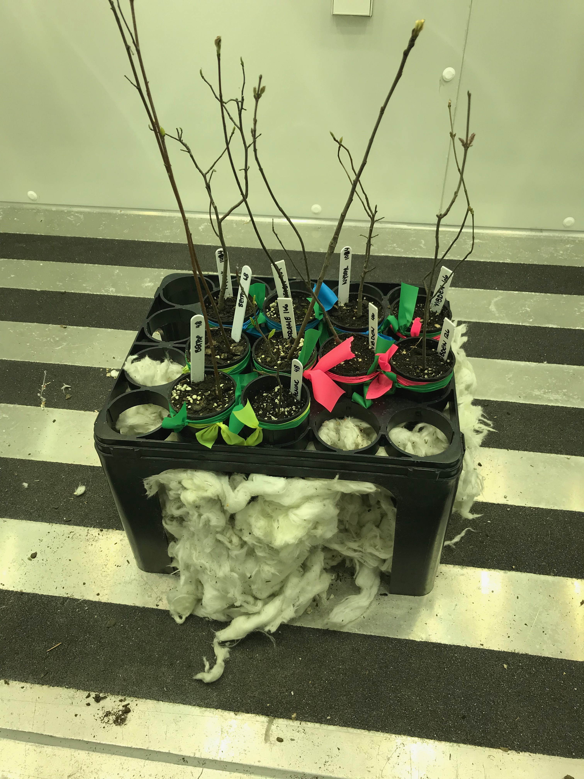
10 SPECIES
3 LEVELS OF CHILLING
4 weeks
6 weeks
8 weeks
FALSE SPRING

